Slide 1
Workflow:
Quantification of telomeric DNA content by Dot Blot
Workflow:
Crosslink HeLa S and HeLa L cells with formaldehyde
Lyse the cells
Sonicate the lysate (shearing DNA and proteins)
HeLa L
HeLa S
bp
500
300
200
100
Sonication pattern
Agarose 1%
Reverse crosslink and isolate DNA
Denature DNA

Slide 2
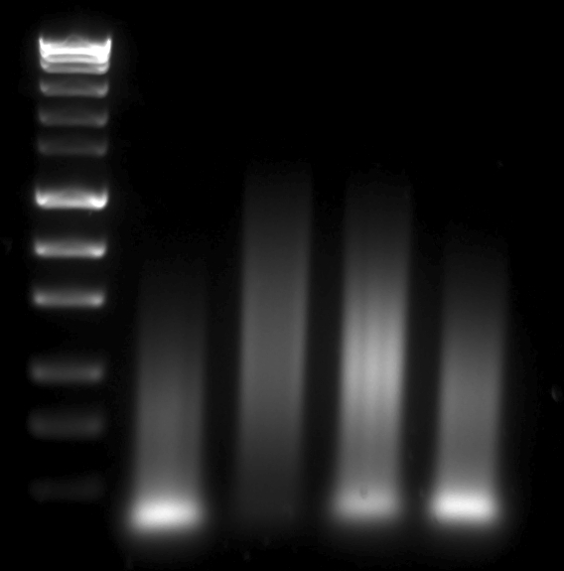
Quantification of telomeric DNA content by Dot Blot
Load DNA on a membrane in a focused dot
Hybridize with radiolabeled P³²-TTAGGG probe (telomere specific)
MassRuler
Express Fwrd
PCR reaction
10 μL 5x GC Phusion Buffer
0.4 μL 25 mM dNTP
0.5 μL 100 μM (TTAGGG)₅
0.5 μL 100 μM (CCCTAA)₅
0.5 μL Phusion Hot Start Polymerase (Finnzyme)
38.1 μL H₂O
Normal Cycle
98°C 30”
98°C 10”
60°C 20”
72°C 30”
72° C 5’
This reaction generates primer/dimer products ranging from 100 bp to some kilobases Under the line 2 in the image is the telomeric probe we are currently using and you can see that it has on average 300bp.
1
2
1500
1000 bp
700
500
300
200
100
Expose and quantify the signal intensity
Agarose 1.5 %
Remove the teloprobe
Hybridyze with Alu probe (non sprecific, serves as a loading control)

Slide 3
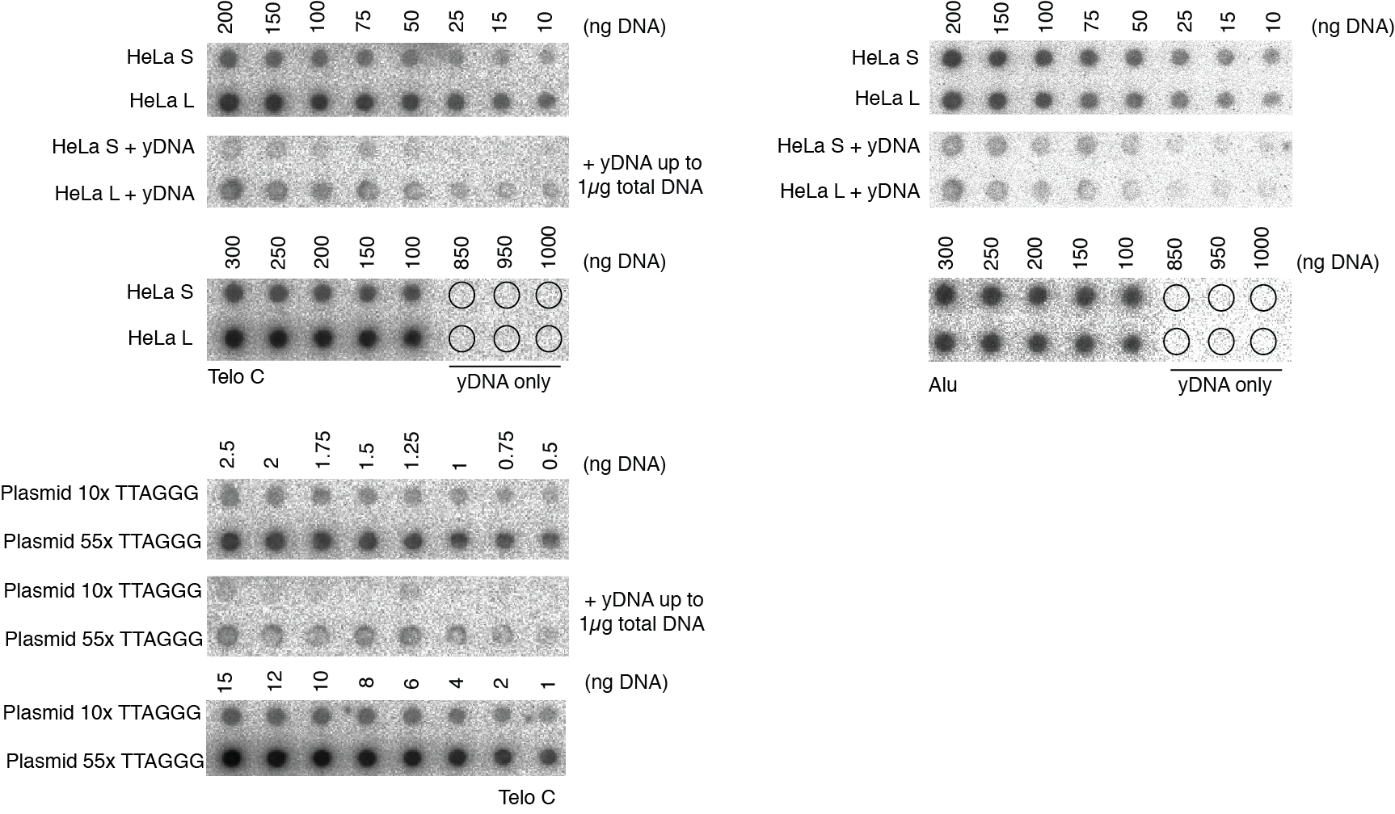
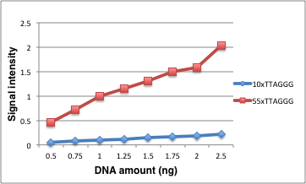
Aim: To compare the total telomeric DNA content by Dot Blot using plasmids which contain defined amount of TTAGGG repeats
the average diference in TTAGGG content between 55xTTAGGG/10x is 9.2x
the overestimation to the difference in the real TTAGGG amount is 1.7 (9.2x/5.5x)
addition of yDNA in excessive amount is affecting the signal intensity
Table 1. Quantificiation of the Dot Blot
* Caviat: The plasmids contain only 330bp of TTAGGG at most and the hybridization efficiency may be different from genomic DNA
Notes:
Telomeric DNA in ChIP experiments
- The amount od DNA in after the isolation from 10% In c=17ng/µL (approximately)
- If I load 50µL of the IP, usualy the input is linear from 3% → 50µL/(10/30)= 15µL
- 15µL*17ng/µL= 255ng of DNA that I load for quatification, Sophie loads 20µL of the IP which is 2.5 less than me which is 102ng
- when I count the chromosomes in my metaphase spreads usually in a full spred I see 256 telomers which is 256/4=64chromosomes (if the average telomere lenght is 10kb then the total telomeric lenght is 2560kb)
- that means that telomeres are 0.064% of the whole genome of HeLa cells
(calculation assumptions : HeLa genome is 64chr/48chr=1.3x bigger than the genome of a normal cell which has 3x109 bp, that means that the HeLa genome has 4 x109 bp)
4 x109 bp is 100%
0.00256 x109 is x → x=0.064%
- that means that out of 255ng telomeres are 0.163ng for me or 0.065ng for Sophie
Plasmid DNA
- The lenght of Alix’s plasmid is 5706 base pairs
- If there are 55xTTAGG that is 55*6=330bp
5706 bp is 100%
330bp is x → x=5.78%
- To load 0.163ng of telomeric DNA from these plasmids I need to load 2.82ng of plasmid DNA

Slide 4
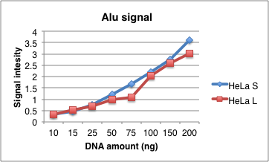
Aims:
To compare the total telomeric DNA content of HeLa S and HeLA L by Dot Blot
To check if presence of foreign DNA (in our case yeast DNA) influences the hybridization efficiencies
yDNA
the integrity of the yDNA used is preserved (the left figure)
if we look in the signal of the Alu sequence we can see that equal amounts of DNA are loaded for both HeLa L and HeLa S (with an exception of the value for 75ng)
yDNA alone doesn’t give any signal (circles in the dot blot)
bp
3000
1000
500

Slide 5
Table 2. Quantificiation of the Dot Blot shown in the slide 4
It seems that the amount of DNA loaded is proportional to the signal intensity only for the first three amounts (10, 15, 25 ng of DNA) and the proportionality is not perfect
From these measurements the average difference in TTAGGG content between HeLaL/HeLa S is 5.5x
The overestimation to the difference observed in the Southern is 2.2 fold (5.5x/2.5x)
yDNA in large quantities (above 800ng) decreased the signal intensity by on average 10 fold, but since the loading was not good this could not be precisely quantified
Notes:
Note: The Telo/Alu ration should be 1 if the loading is perfect

Slide 6
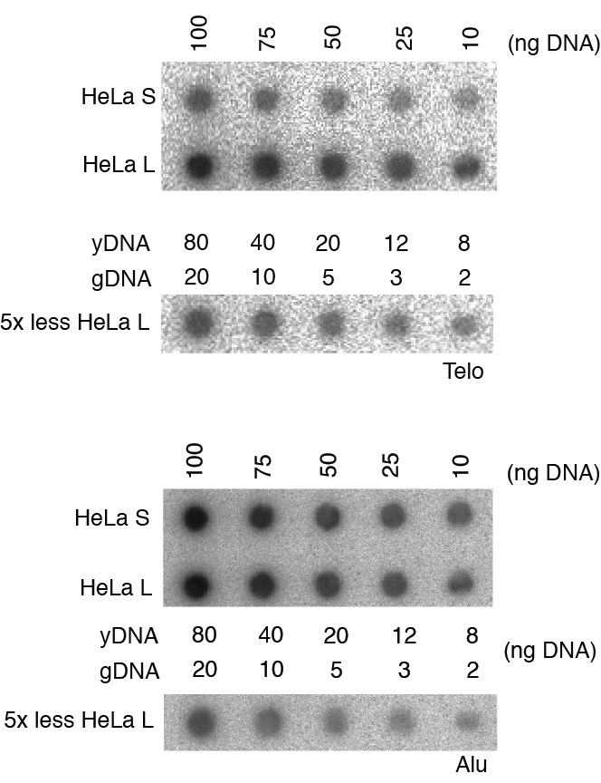
Aims:
To see if we can achieve a dilution of HeLa L for which the ratio of signal intensities will
According to the Southern blot analysis the difference between HeLa S and HeLa L is 2.5x that means that the abundance of the non telomeric DNA on the Dot Blot is 2.5x higher in HeLa S. Since we have observed that by adding extensive amount of yDNA the signal intensity is reduced (due to membrane saturation or competition/crowding during hybridization) we wanted to check if we can dilute the HeLa L and add yDNA to mimic the gDNA content of HeLa S to the extent that the signal intensities of HeLa S and HeLa L would be the same. I have loaded different ratios of HeLa L (2.5x, 3x, 4x, 5x, 7.5x, 10x less) and checked if the ratio between HeLa S and diluted HeLa L would be 1 or close to 1 in some of the cases.
When the dot blots shown on the right were quantified I have observed that:
the addition of yDNA in small quantities doesn’t not influence the signal intensitions
the ratio between HeLa S and HeLa L 5x less was on average 1.2 and the expected is 1.1
Notes:
According to the Southern blot analysis the difference between HeLa S and HeLa L is 2.5x that means that the abundance of the non telomeric DNA on the Dot Blot is 2.5x higher in HeLa S. Since we have observed that by adding extensive amount of yDNA the signal intensity is reduced (due to membrane saturation or competition/crowding during hybridization) we wanted to check if we can dilute the HeLa L and add yDNA to mimic the gDNA content of HeLa S to the extent that the signal intensities of HeLa S and HeLa L would be the same. I have loaded different ratios of HeLa L (2.5x, 3x, 4x, 5x, 7.5x, 10x less) and checked if the ratio between HeLa S and diluted HeLa L would be 1 or close to 1 in some of the cases.

